Slide 1
Day 3 – JavaScript Fundamental

Slide 2
Recap
All about JavaScript
Variables and Values
Data Types (Primitive and Objects)
Operators
Operator Precedence
Strings and Template literal
Comments
Conversion and Coercion
Alert and Prompt

Slide 3
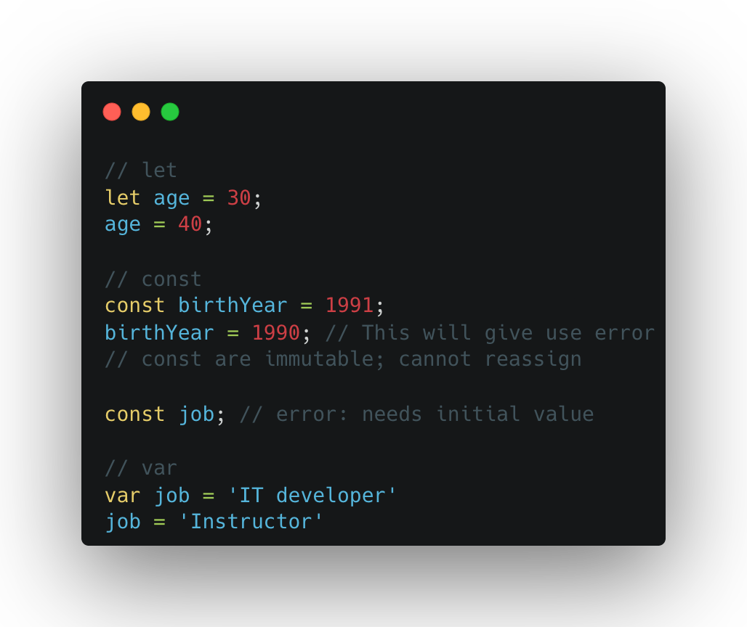
Missing Part of Day 2 (let, const, and var)

Slide 4
What is this scope? (Block and Function)

Slide 5
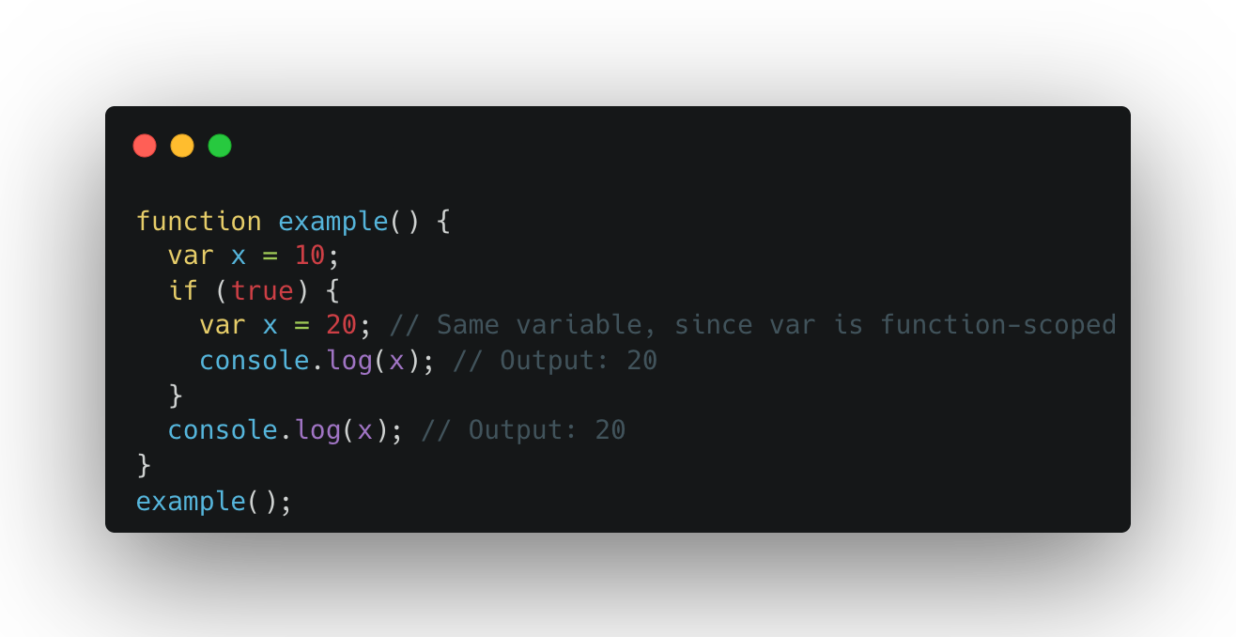
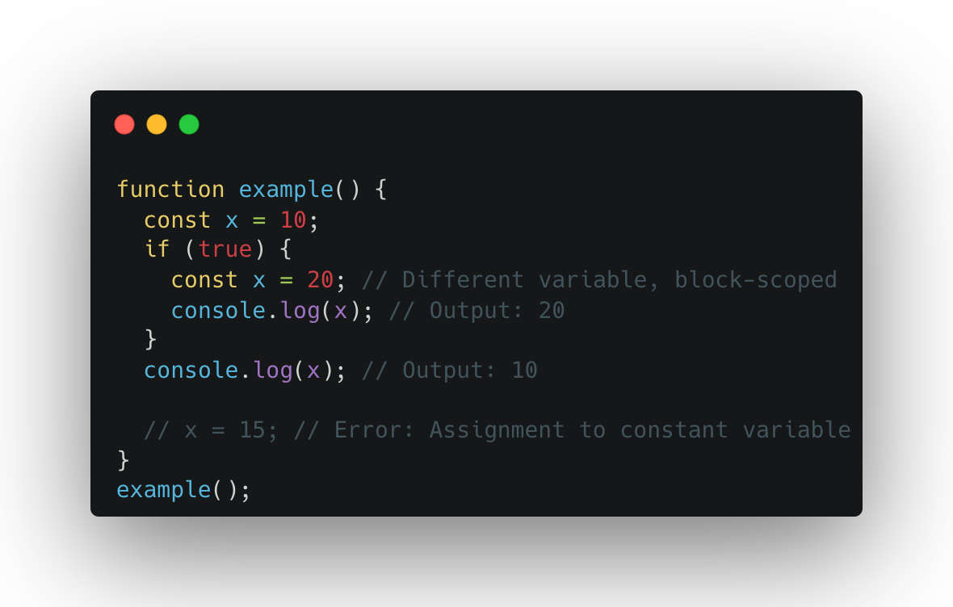
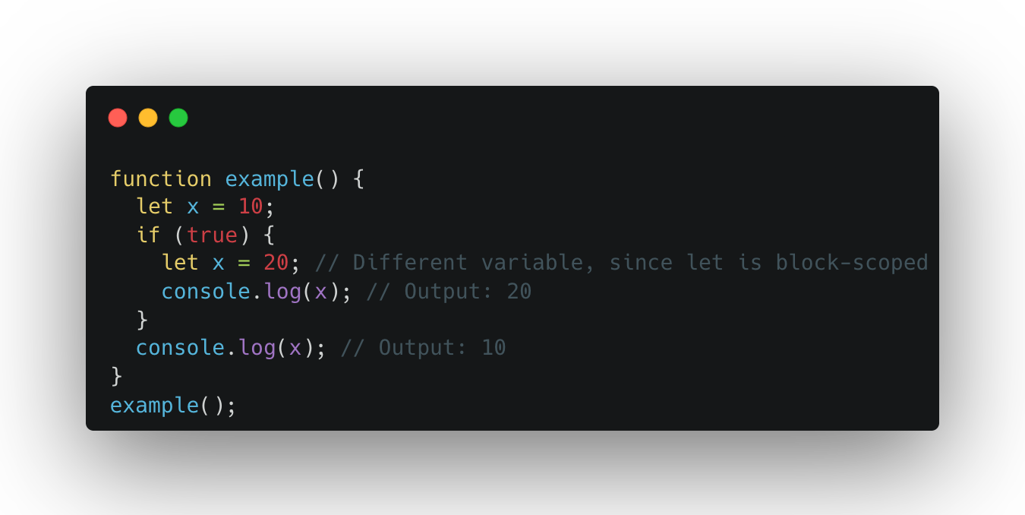
Then what's the difference

Slide 6
Control Statement and Loops
If……else statement
Nested if……else statement
Multiple if statement
Switch Statement
Ternary Operator
For loop
While loop

Slide 7
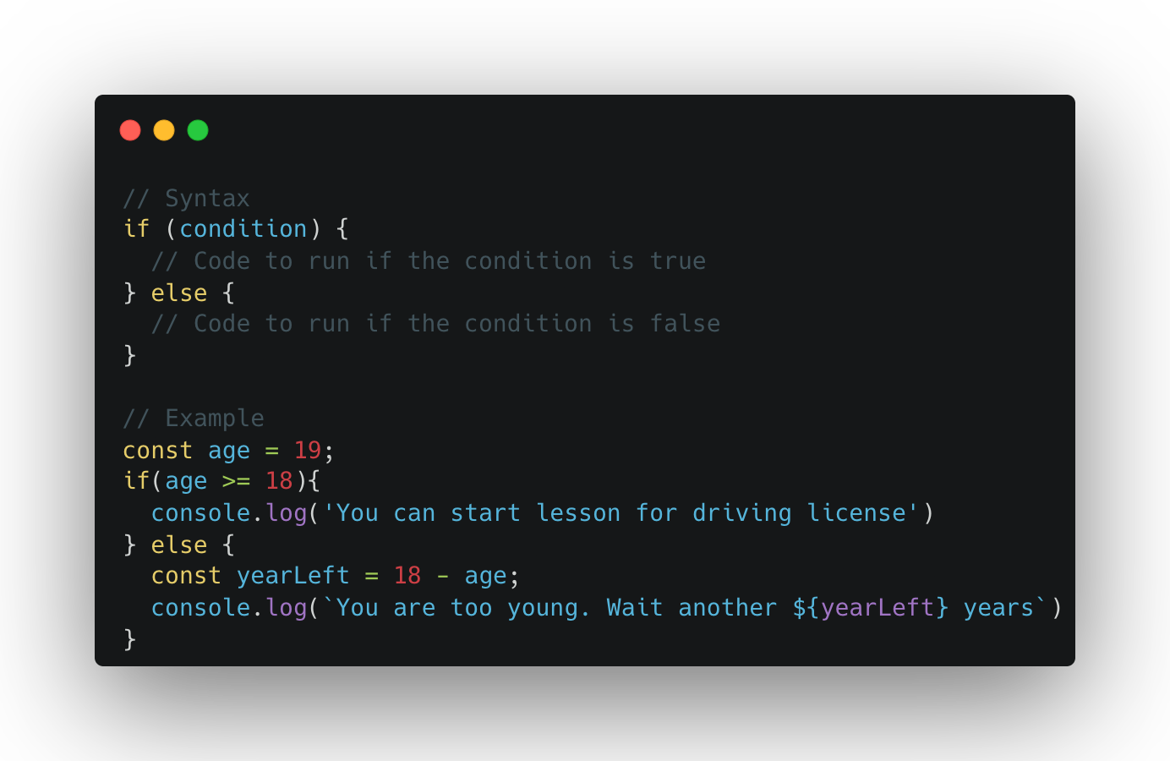
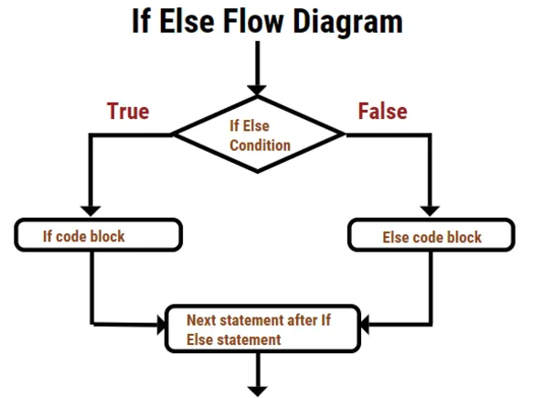
If……else statement
Notes:
An if...else statement in JavaScript is used to make decisions in your code. It allows you to execute one block of code if a certain condition is true and another block of code if the condition is false.

Slide 8
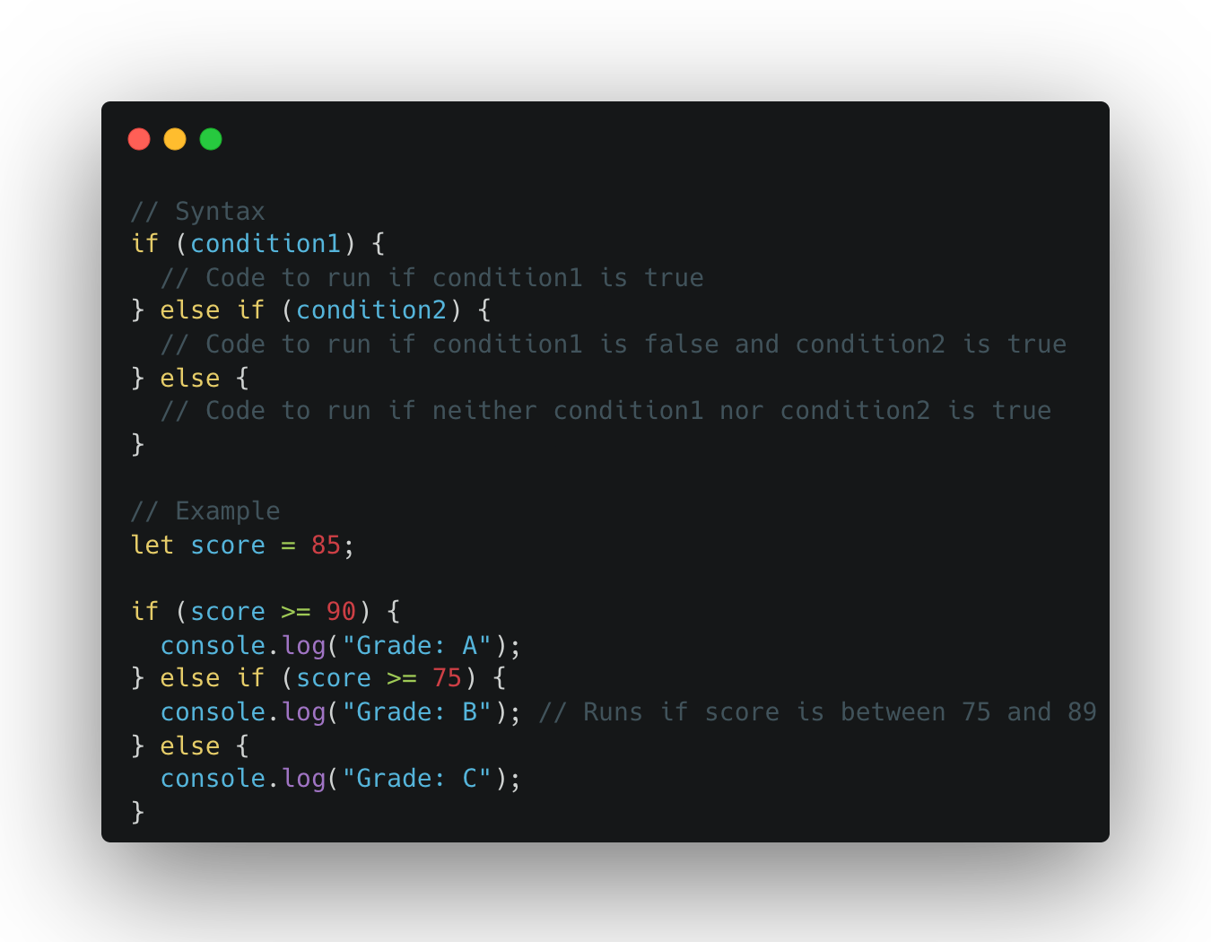
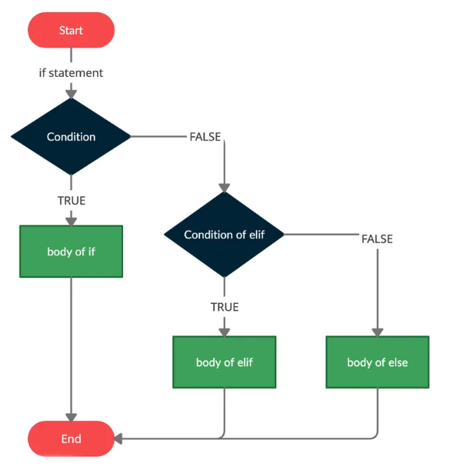
If…elseif…else statement

Slide 9
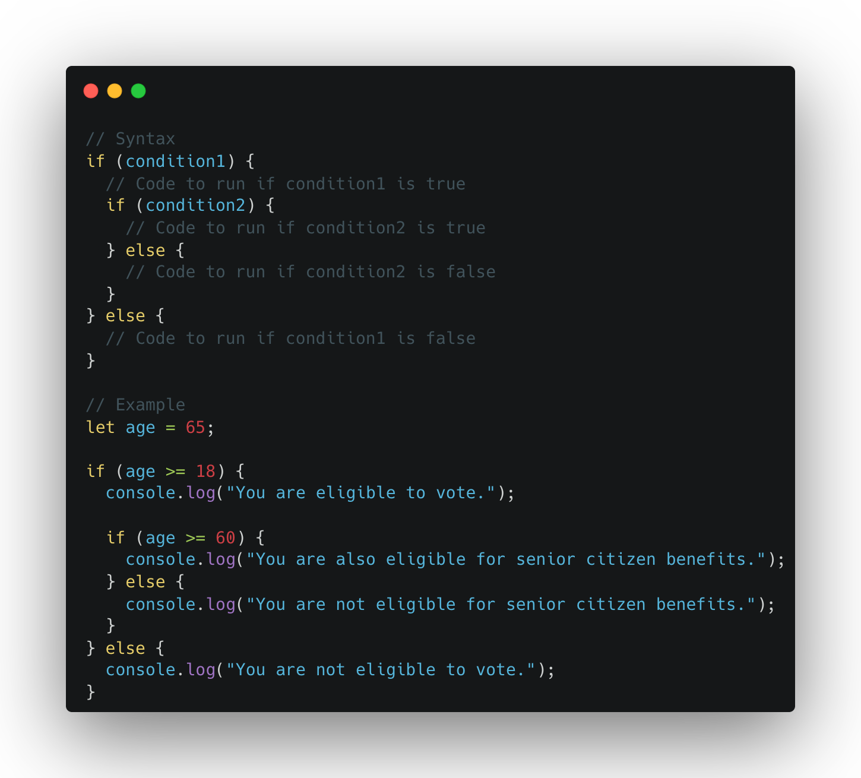
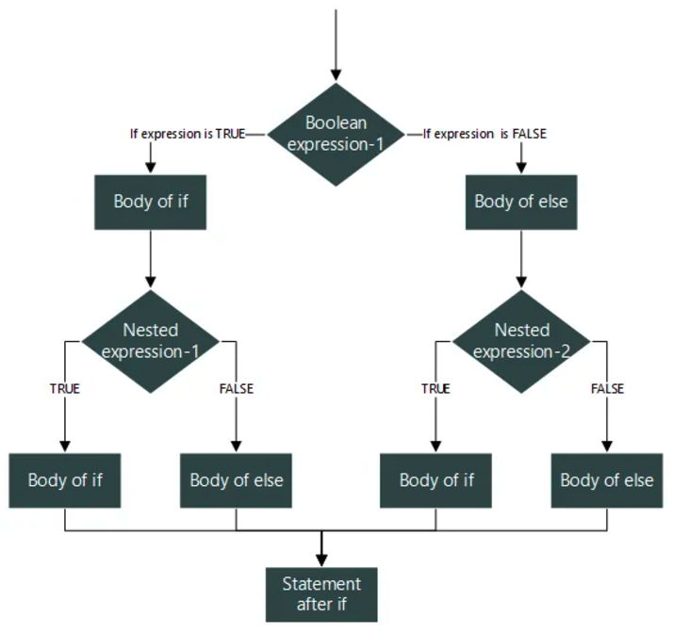
Nested if……else statement
Notes:
A nested if...else statement means placing one if...else block inside another. This allows you to check multiple conditions in a hierarchical or dependent way.

Slide 10
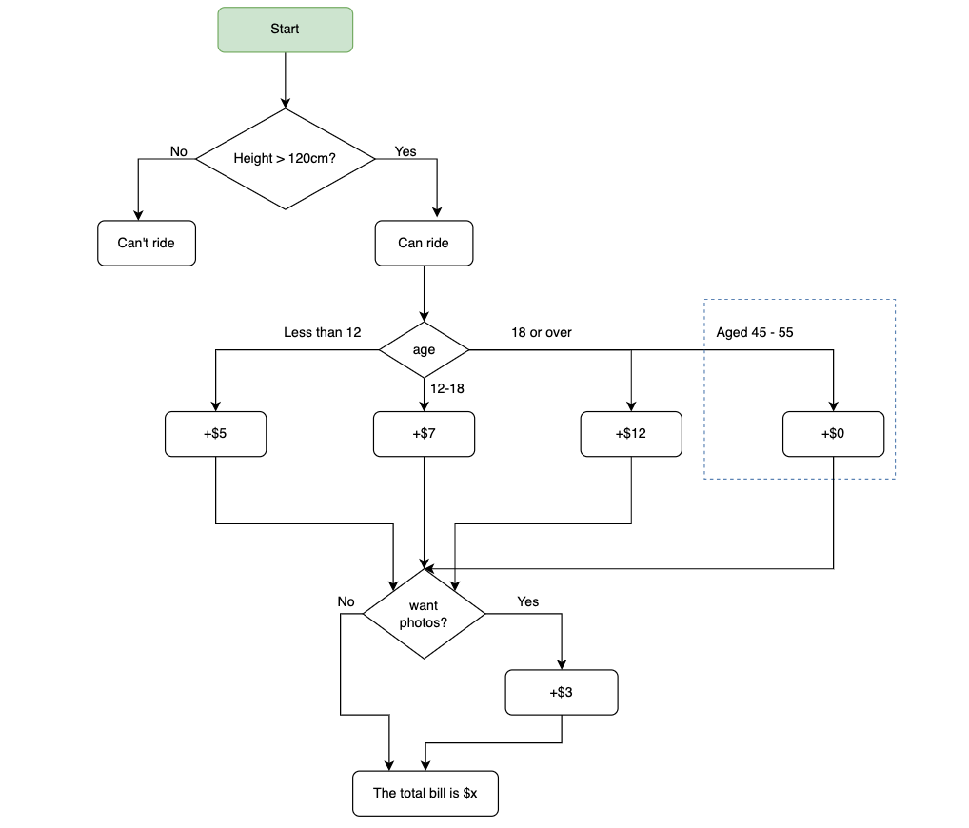

Slide 11
Truthy and Falsy Value !!!!!!!!
Notes:
In JavaScript, a value can be truthy or falsy depending on how it behaves when used in a Boolean context (like in conditions of if statements). These terms describe how values are evaluated in boolean expressions.
Truthy values are those that are considered true when evaluated in a Boolean context.
Falsy values are those that are considered false when evaluated in a Boolean context.
Falsy Values
A falsy value is a value that evaluates to false when used in a condition.
There are only 6 falsy values in JavaScript:
false (the Boolean value false)
0 (the number zero)
"" (an empty string)
null
undefined
NaN (Not-a-Number)

Slide 12
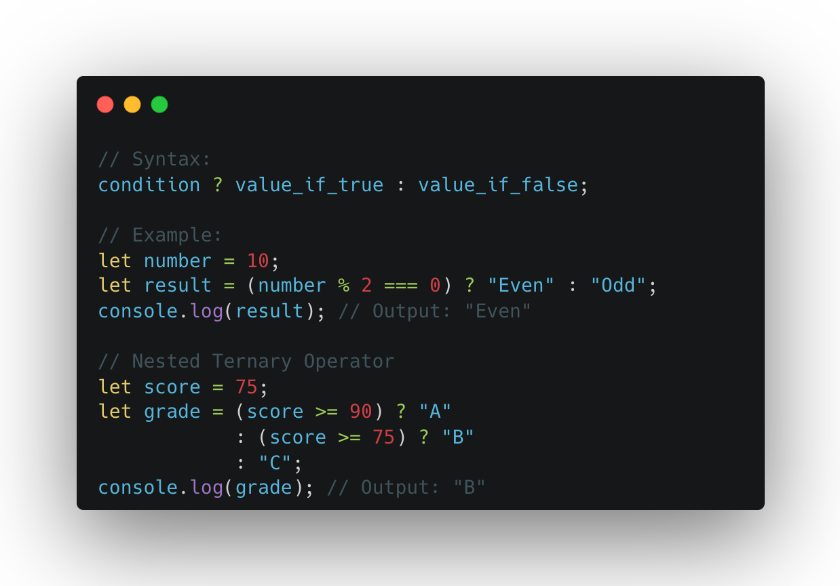
Ternary Operator
Notes:
The ternary operator is a shorthand way to write an if...else statement. It is a conditional operator that takes three operands:
A condition to test.
A value to return if the condition is true.
A value to return if the condition is false.

Slide 13
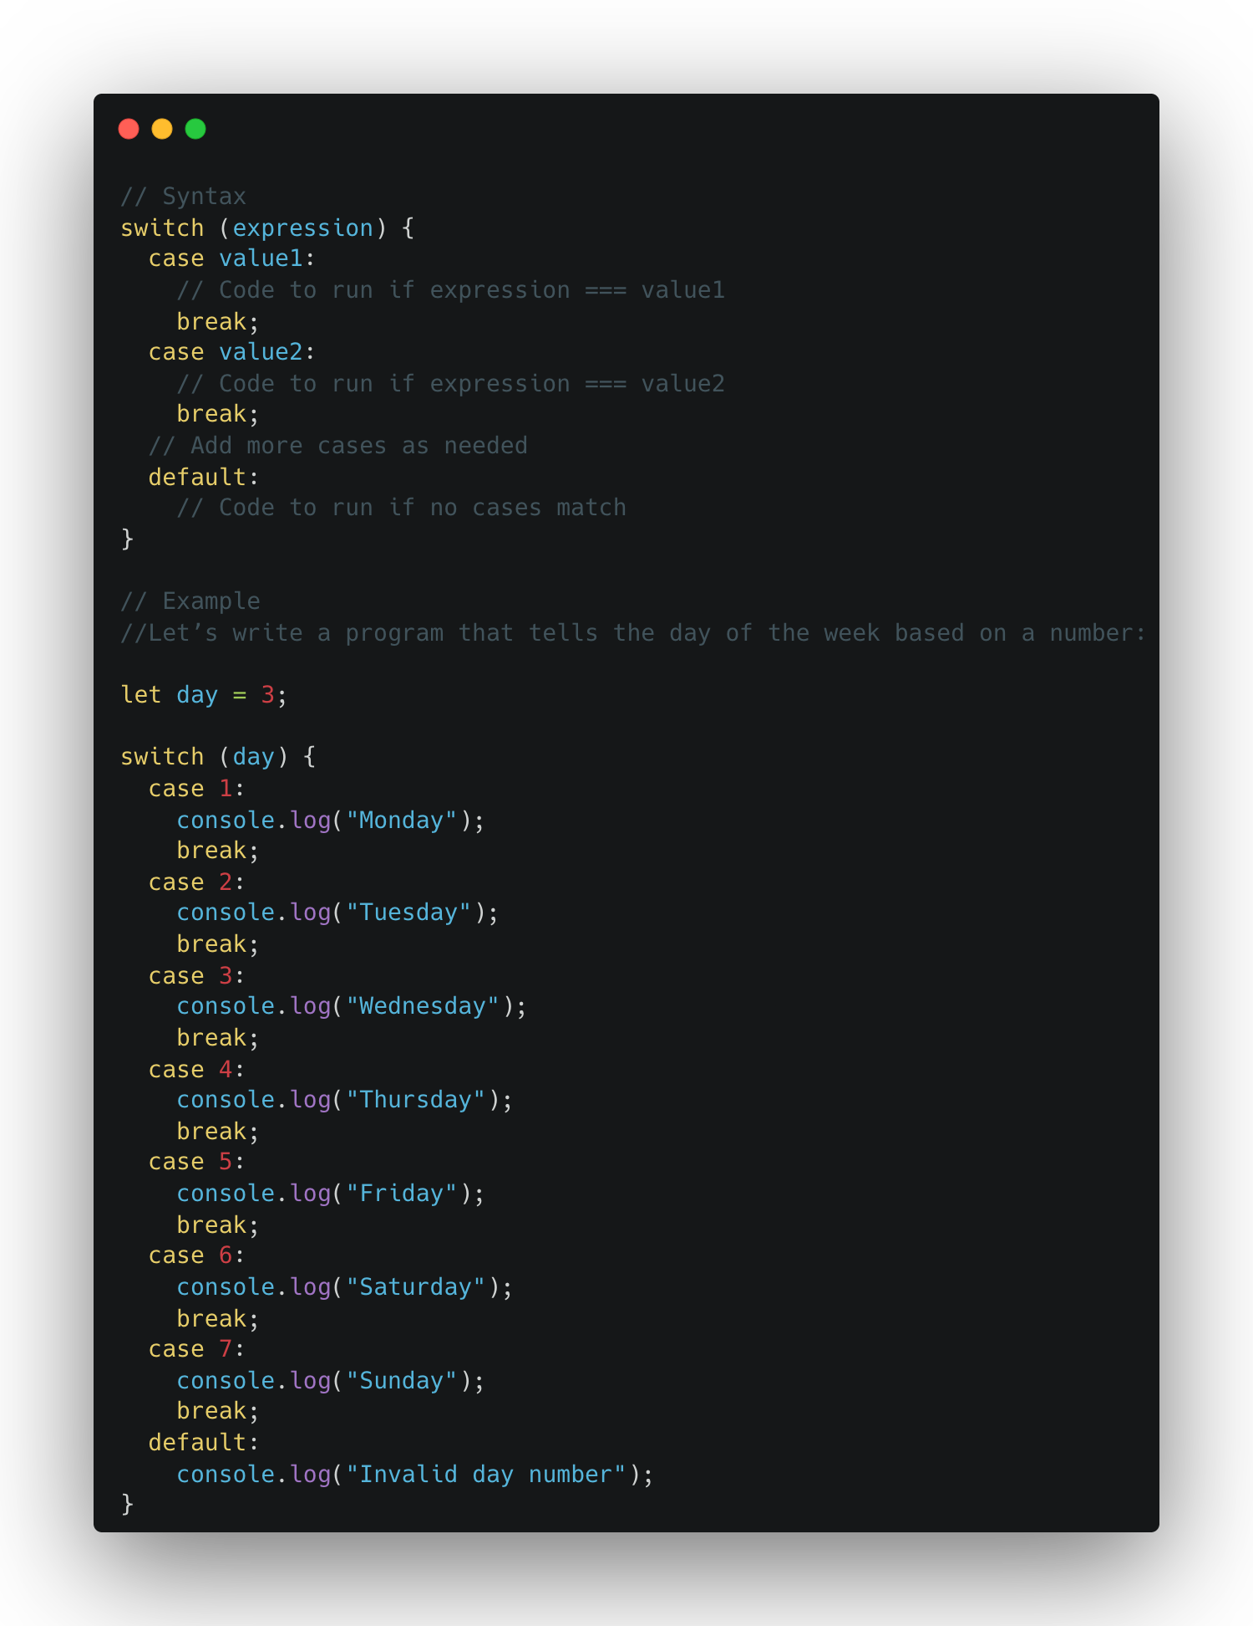
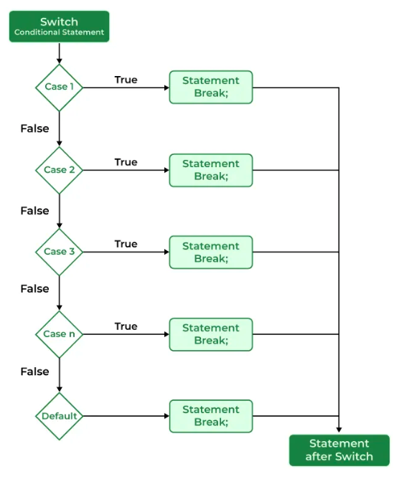
Switch statement
Notes:
A switch statement in JavaScript is used to execute one block of code from multiple options based on the value of an expression. It’s an alternative to using multiple if...else if conditions and is often more readable when dealing with many cases.

Slide 14
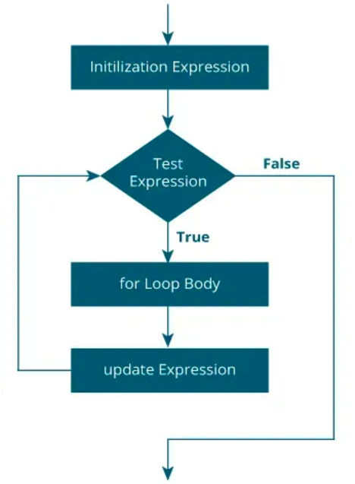
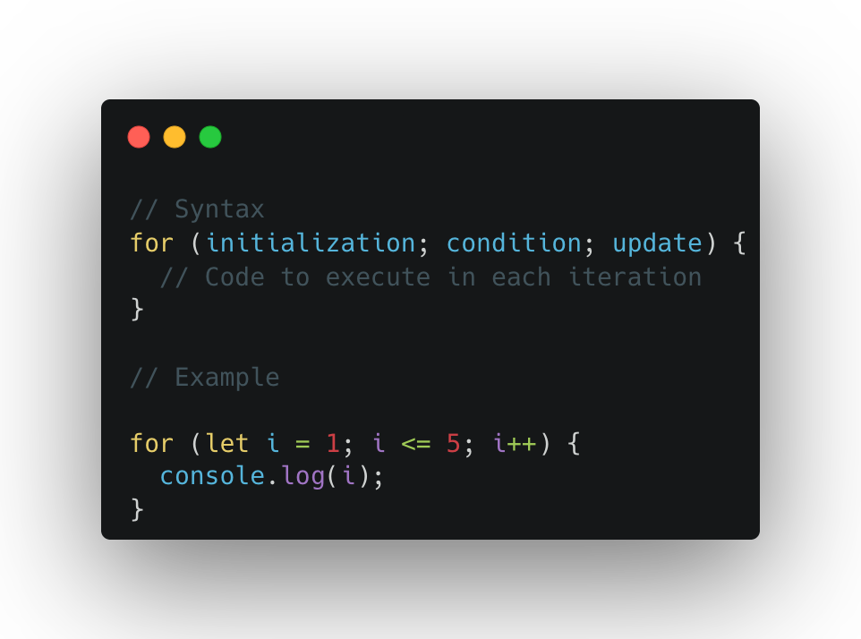
For loop
Notes:
A for loop in JavaScript is used to repeat a block of code a specific number of times. It's one of the most common looping structures and is great for iterating over arrays, numbers, or repetitive tasks.

Slide 15
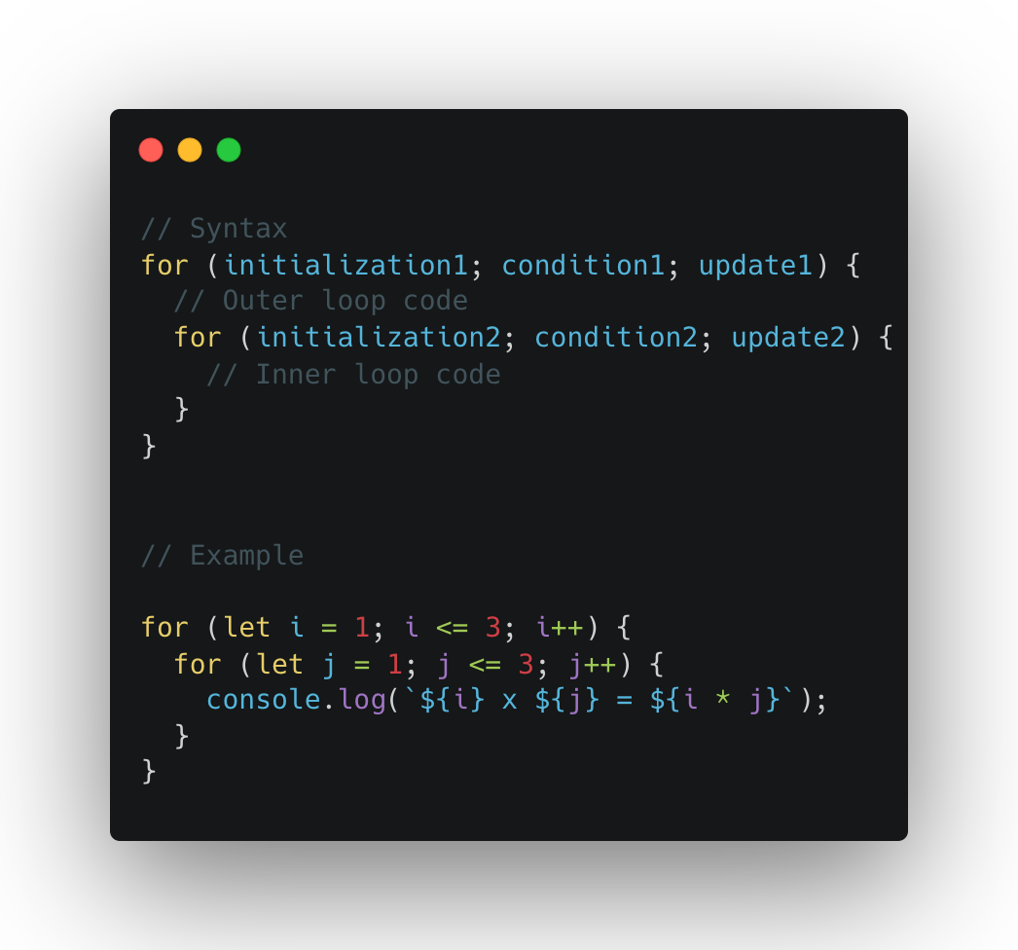
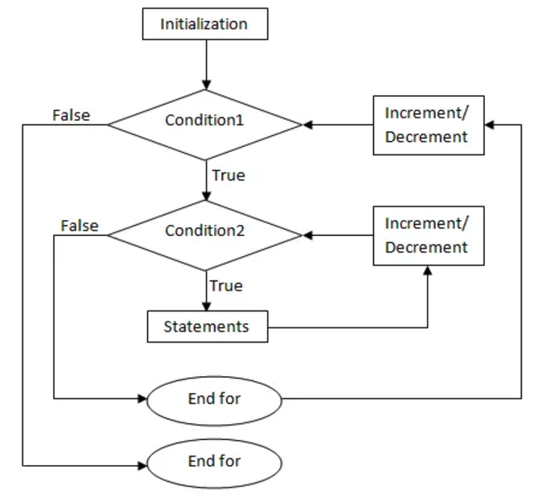
Nested For loop
Notes:
A nested for loop is a for loop inside another for loop. It's commonly used when dealing with multi-dimensional data or scenarios where one set of iterations depends on another.

Slide 16
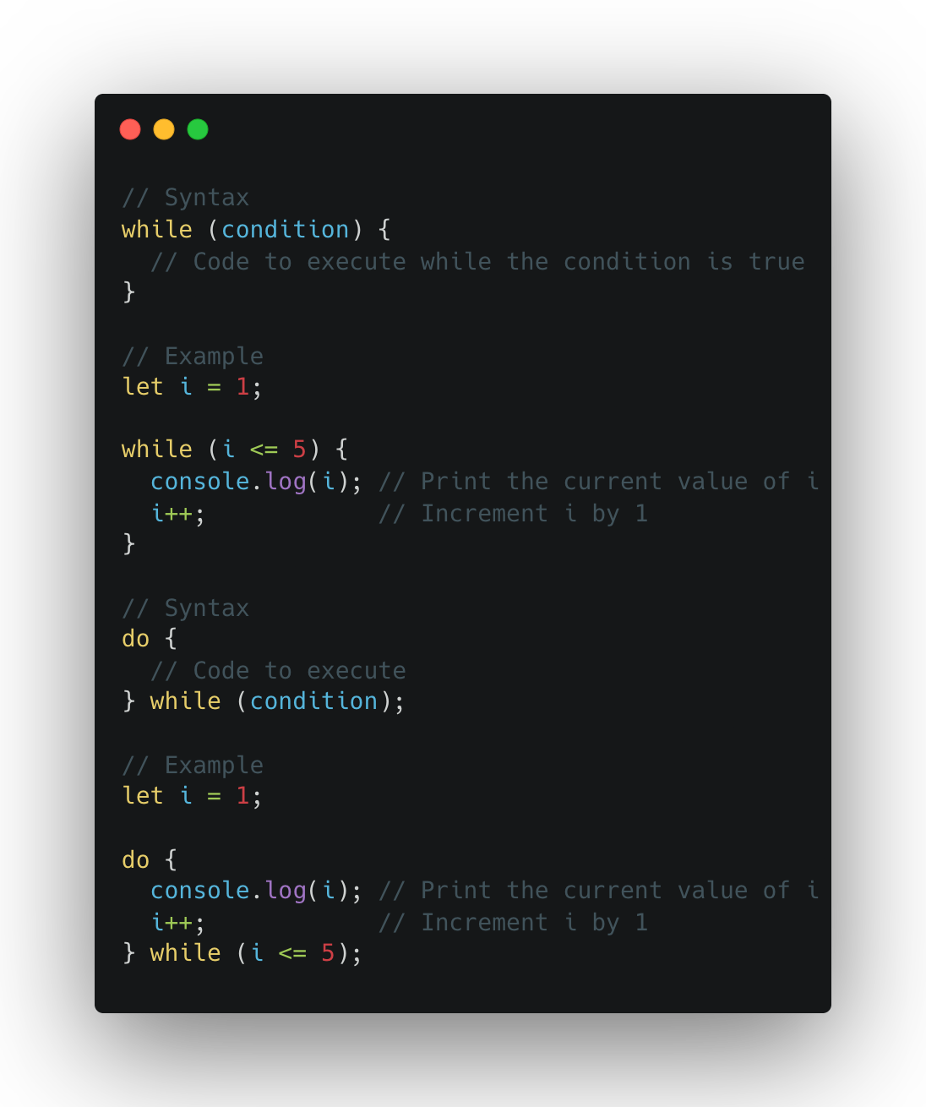
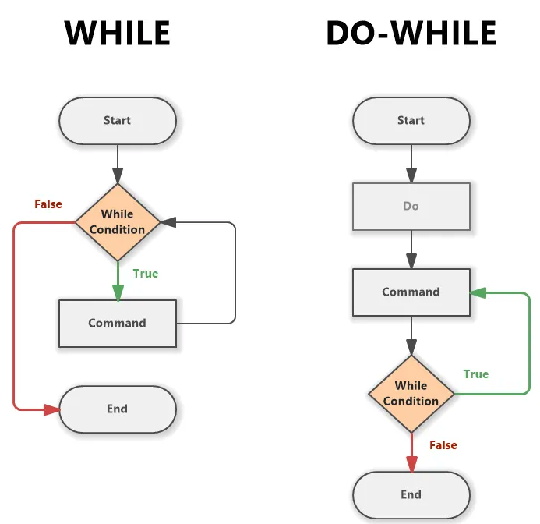
While and do-while loop
Notes:
Both while and do...while loops are used for repeating a block of code based on a condition. The main difference is when the condition is checked:
while loop: Checks the condition before executing the code block.
do...while loop: Executes the code block at least once, then checks the condition.

Slide 17
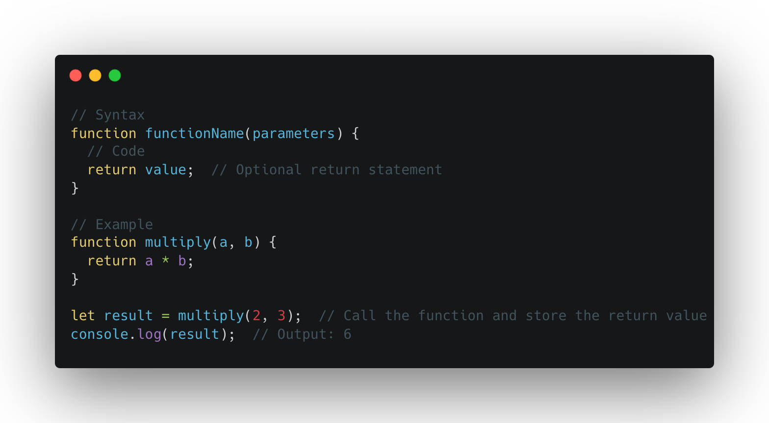
Let’s Intro with Function or Methods
Notes:
A function in JavaScript is a block of reusable code designed to perform a specific task. Functions help to avoid repeating code and make programs more organized.
1. Function Declaration
A function declaration is the most common way to define a function. It uses the function keyword followed by the function name, parameters (optional), and a block of code.
2. Function Call
A function call is when you invoke or "call" a function to execute the code inside it. You call the function by its name followed by parentheses.
3. Function Execution
When a function is executed, the code inside the function runs. The function only executes when it is called. Functions can return a value using the return keyword, or they may perform actions without returning anything.

Slide 18
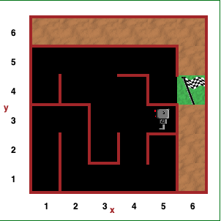
Let’s have some fun now (Game to learn programming)
https://reeborg.ca/index_en.html

Slide 19
Feedback
What went well?
What went wrong?
What did you learn?

Slide 20
Credit
https://carbon.now.sh/

Slide 21
I believe that you learn the most if you don’t learn alone but find learning partners and other people with similar interest. - Unknown

